Slide 1
TCP协议
报告人：徐 明 博士/教授/博导 Eamil： mxu(at)hdu.edu.cn 电 话： 186 2687 8585 2015.12

Slide 2
主要内容
1
TCP基本原理
1
2
TCP报文段格式
3
TCP软件整体结构
4
TCP控制块
1
TCP状态机
5
6
TCP输如进程及输入状态机
7
TCP输出进程及输出状态机
1
8
流量和拥塞控制
9
TCP定时器管理

Slide 3
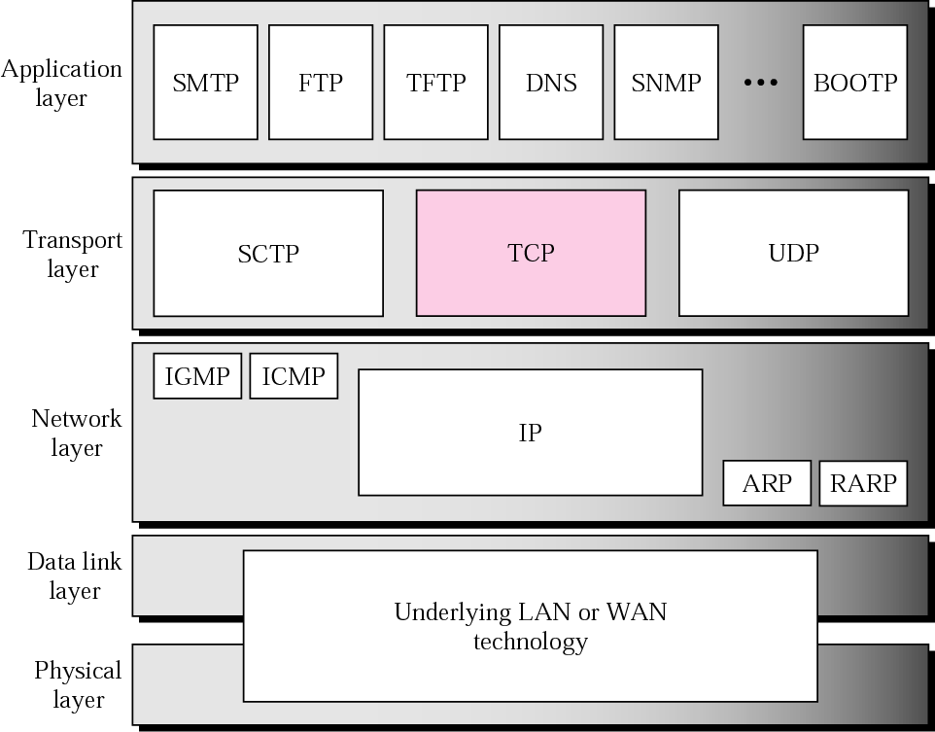
TCP/IP Protocols

Slide 4
1. TCP的基本原理
TCP：面向连接的可靠字节流传输层协议
面向连接：打开、关闭（同时打开、半关闭、同时关闭）；
差错控制：序号和确认重传机制（提供可靠性）；
流量控制：滑动窗口机制（速度匹配问题）；
拥塞控制：慢启动、加法增大、乘法减策略调整发送窗口大小；
紧急数据：用于控制数据流，可直接交付应用进程；
定时机制

Slide 5
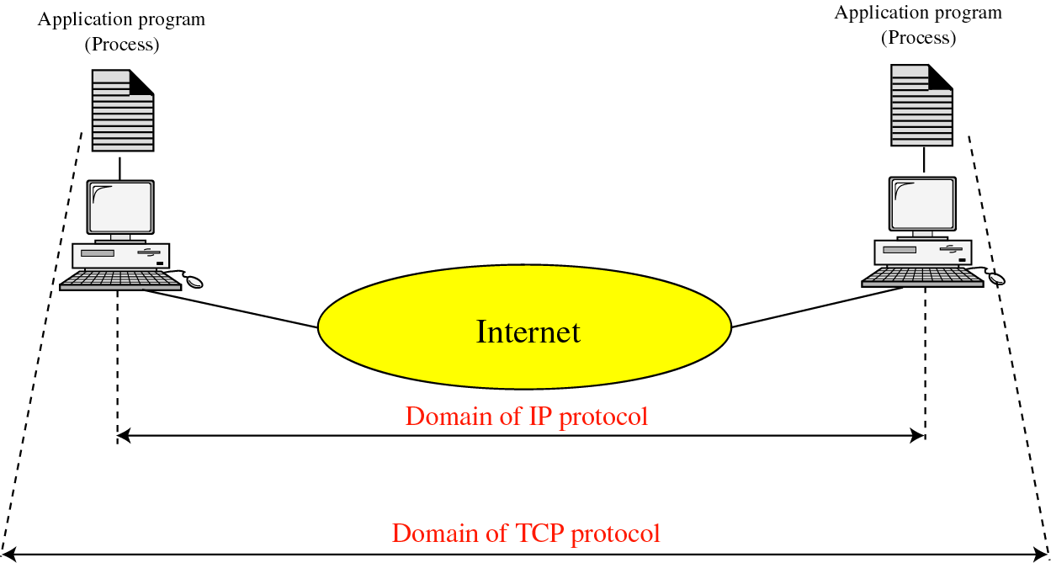
Process-to-Process Communication
For client/server communication
we must define the
  Local host
  Local client program
  Remote host
  Remote server program

Slide 6
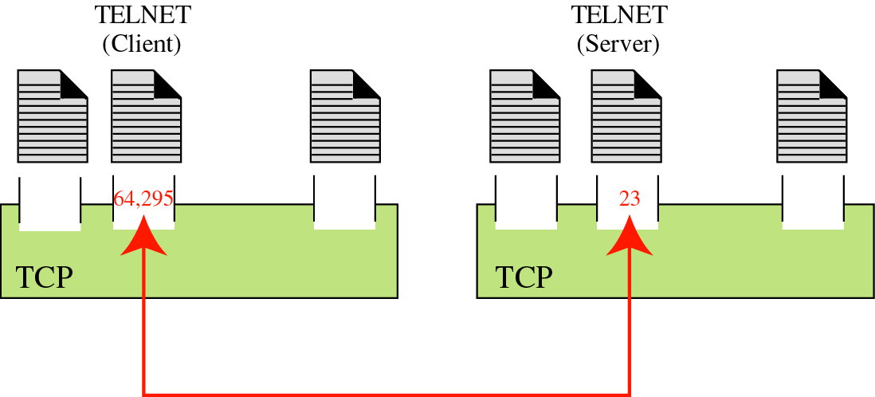
Port numbers :
  ~ mentioned in UDP chapter

Slide 7
Well-known port in TCP
Port | Protocol | Description
7 | Echo | Echoes a received datagram back to the sender
9 | Discard | Discards any datagram that is received
11 | Users | Active users
13 | Daytime | Returns the date and the time
17 | Quote | Returns a quote of the day
19 | Chargen | Returns a string of characters
20 | FTP,data | File transfer Protocol for data
21 | FTP,control | File transfer Protocol for control
23 | TELNET | Terminal Network
25 | SMTP | Simple Mail Transfer Protocol
53 | DNS | Domain Name Server
67 | BOOTP | Bootstrap protocol
79 | Finger | finger
80 | HTTP | Hypertext Transfer Protocol
111 | RPC | Remote Procedure Call

Slide 8
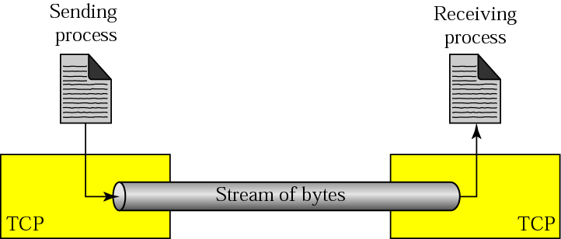
Stream delivery

Slide 9
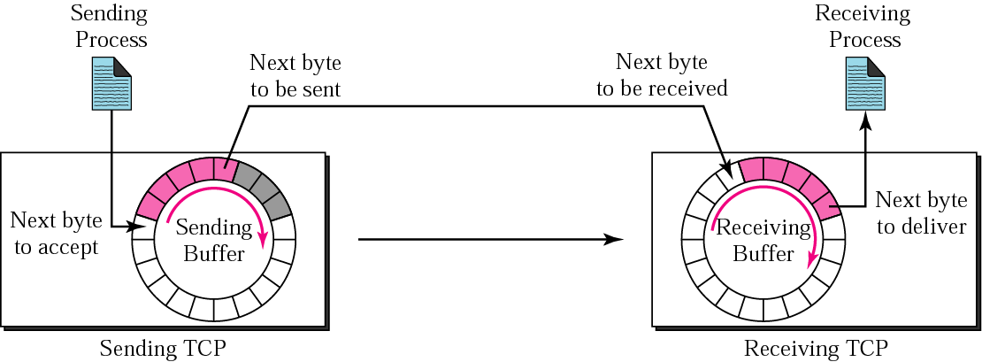
Sending and receiving buffers
The sending process and the receiving process may not produce and consume data at the same speed, TCP needs buffers for storage

Slide 10
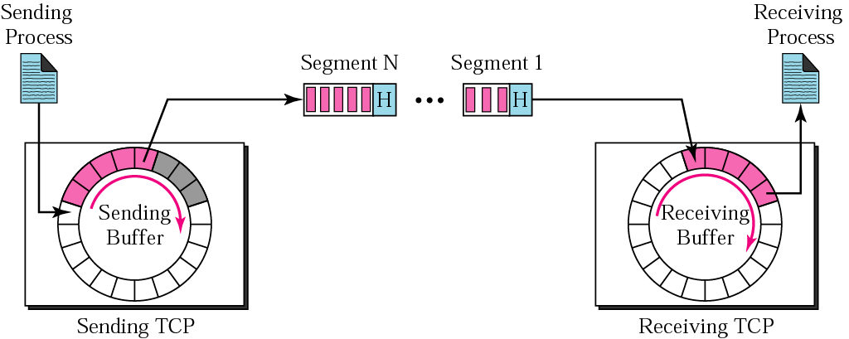
TCP segments
IP layer, as a service provider for TCP, needs to send data in packets, not as a stream of bytes.
TCP groups a number of bytes together into a packet called segment

Slide 11
Socket addresses
  ~ a combination of IP address and port number
  ~ to make a connection for each end
  ~ to need a pair of socket addresses: client and server socket address
  These four pieces of information are part of the IP header (IP address) and TCP header (port number)

Slide 12
TCP FEATURES
To provide the services mentioned in the previous section, TCP has several features that are briefly summarized in this section.
The topics discussed in this section include:
  Numbering System
  Flow Control
  Error Control
  Congestion Control

Slide 13
Numbering system
TCP keeps track of the segment being transmitted or received using sequence number and acknowledge number
These number is used for flow and error control
The bytes of data being transferred in each connection are numbered by TCP
The numbering starts with a randomly generated number (b/w 0 ~ 2³²-1)

Slide 14
Numbering system
When TCP receives bytes of data from the process and stores them in sending buffer
After numbering the bytes, TCP assigns sequence number to each segment that is being sent
The value of the sequence number field in a segment defines the number of the first data byte contained in that segment
The value of the acknowledgment field in a segment defines the number of the next byte a party expects to receives. The acknowledgment number is cumulative

Slide 15
Example
Suppose a TCP connection is transferring a file of 5000 bytes. The first byte is numbered 10001. What are the sequence numbers for each segment if data is sent in five segments, each carrying 1000 bytes?
Solution:
The following shows the sequence number for each segment:
Segment 1 ➡ Sequence Number: 10,001 (range: 10,001 to 11,000)
Segment 2 ➡ Sequence Number: 11,001 (range: 11,001 to 12,000)
Segment 3 ➡ Sequence Number: 12,001 (range: 12,001 to 13,000)
Segment 4 ➡ Sequence Number: 13,001 (range: 13,001 to 14,000)
Segment 5 ➡ Sequence Number: 14,001 (range: 14,001 to 15,000)

Slide 16
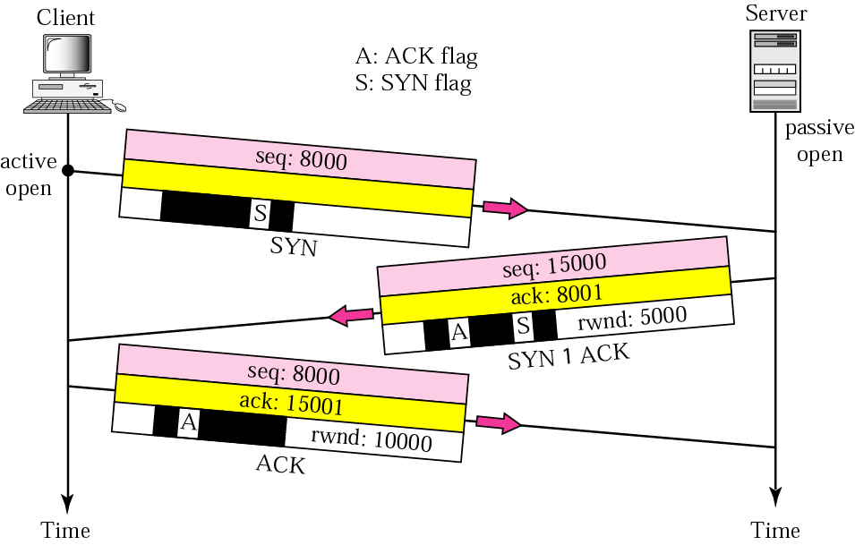
Connection establishment using three-way handshaking

Slide 17
Connection establishment using three-way handshaking
A SYN segment cannot carry data, but it consumes one sequence number.
A SYN + ACK segment cannot carry data, but does consume one sequence number.
An ACK segment, if carrying no data, consumes no sequence number.

Slide 18
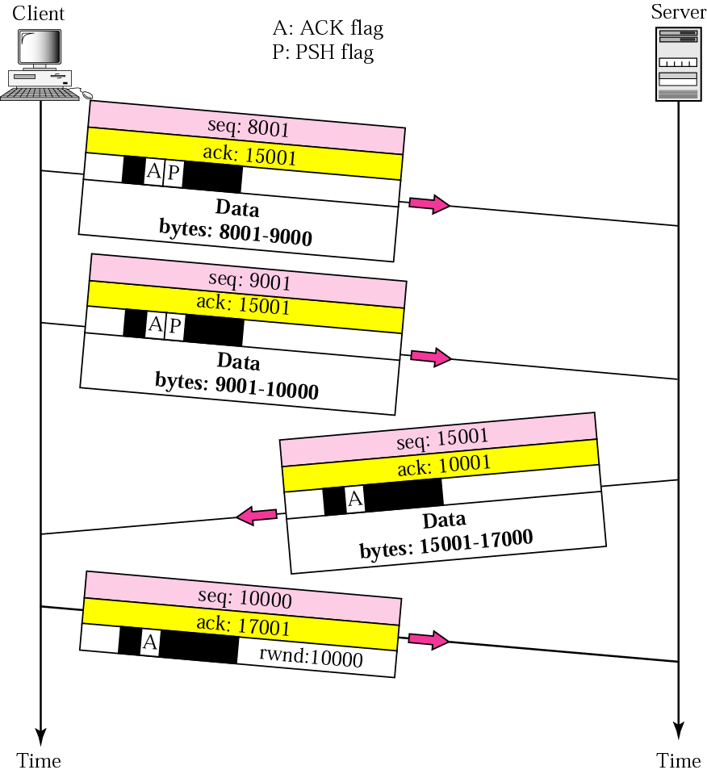
Data transfer
The FIN segment consumes one sequence number if it does not carry data

Slide 19
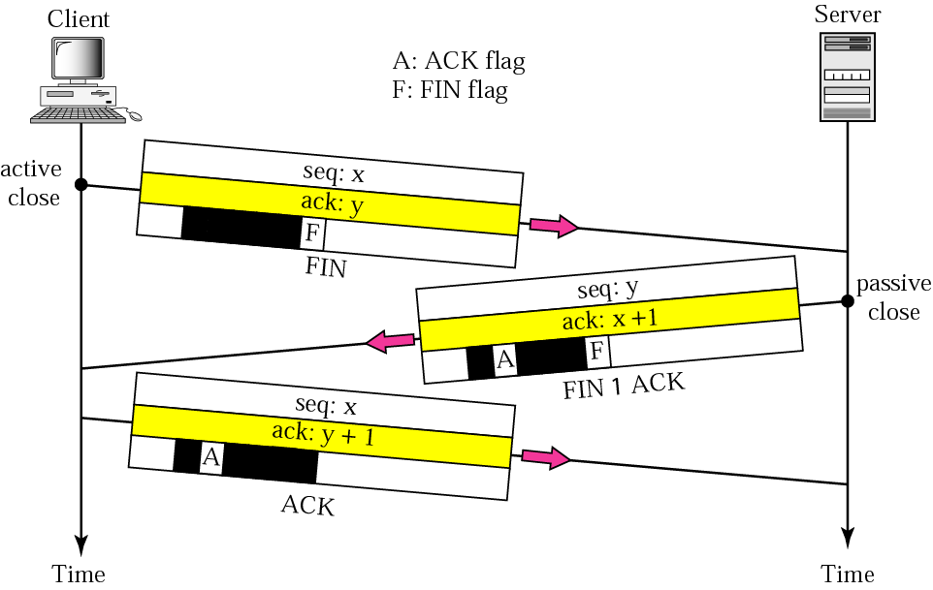
Connection termination using three-way handshaking
The FIN + ACK segment consumes one sequence number if it does not carry data

Slide 20
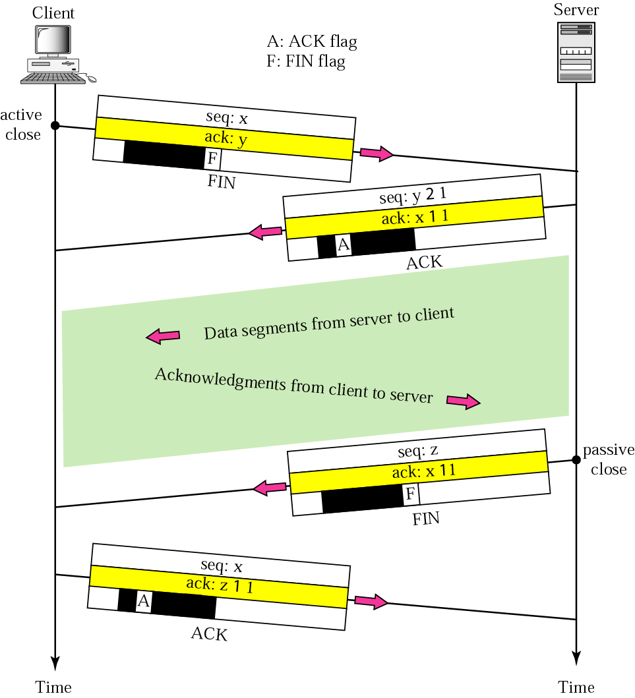
Half Close
One end stops sending data while still receiving data.
  Normally initiated by client.
  It can occur when the server needs all data before processing can begin
Sorting example
  The client, after sending all data to be sorted, can close the connection in the outbound direction.
  However, the inbound direction must remain open to receive the sorted data.

Slide 21
TCP STATE TRANSITION DIAGRAM
finite state machine:At any moment, the machine is in one of the state
TCP states
State Description
----- --------------
CLOSED There is no connection
LISTEN The server is waiting for calls from the client
SYN-SENT A connection request is sent; waiting for acknowledgment
SYN-RCVD A connection request is received
ESTABLISHED Connection is established
FIN-WAIT-1 The application has requested the closing of the connection
FIN-WAIT-2 The other side has accepted the closing of the connection
CLOSING Both sides have decided to close simultaneously
TIME-WAIT Waiting for retransmitted segments to die
CLOSE-WAIT The server is waiting for the application to close
LAST-ACK The server is waiting for the last acknowledgment

Slide 22
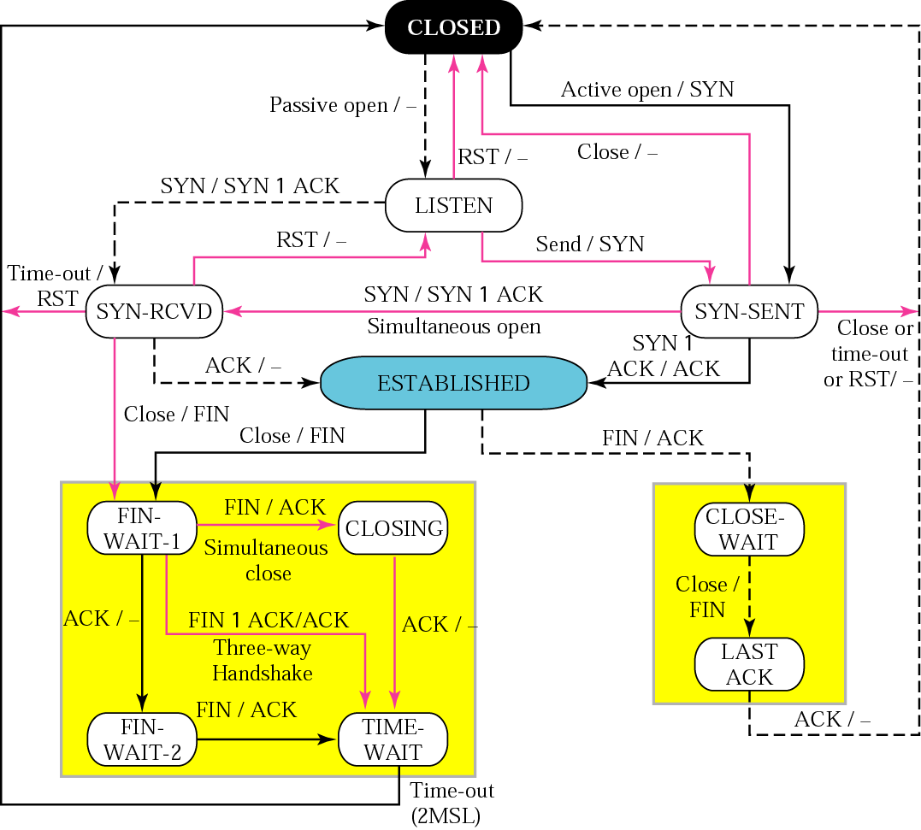
STATE TRANSITION DIAGRAM
- state : ovals
- Transition from one to another state : directed line
- values on line
input / output
- Dotted line : server
- Solid line : client
- Thin line : unusual situation

Slide 23
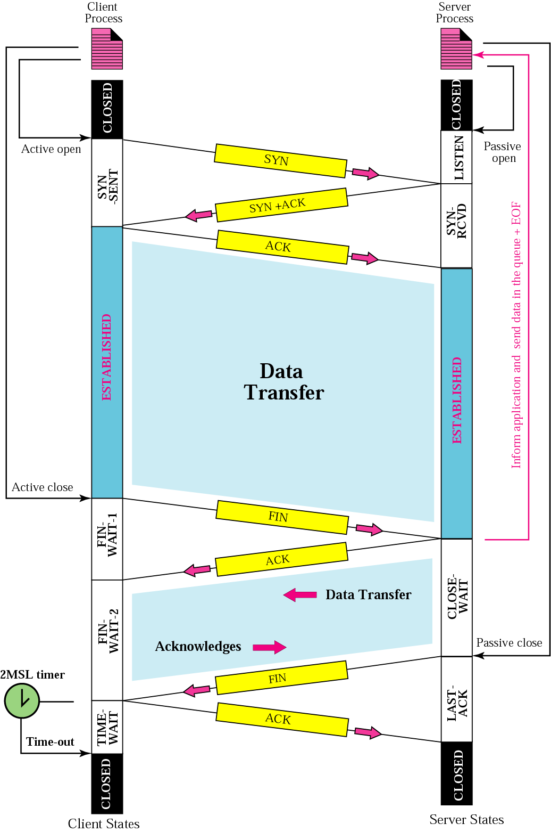
Connection scenario
The common value for MSL (Maximum Segment Lifetime) is between 30 seconds and 1 minute

Slide 24
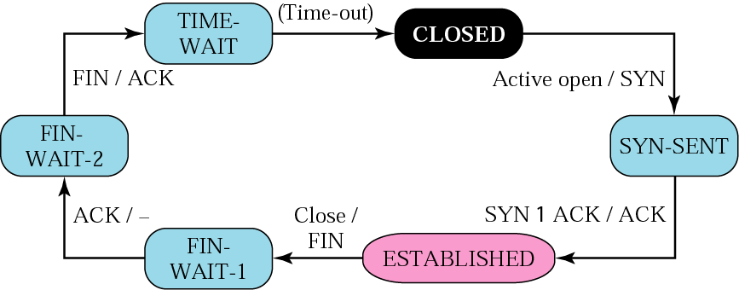
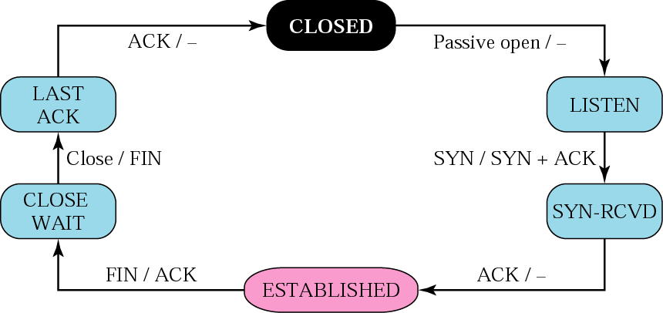
STATE TRANSITION DIAGRAM
Client states
Server states

Slide 25
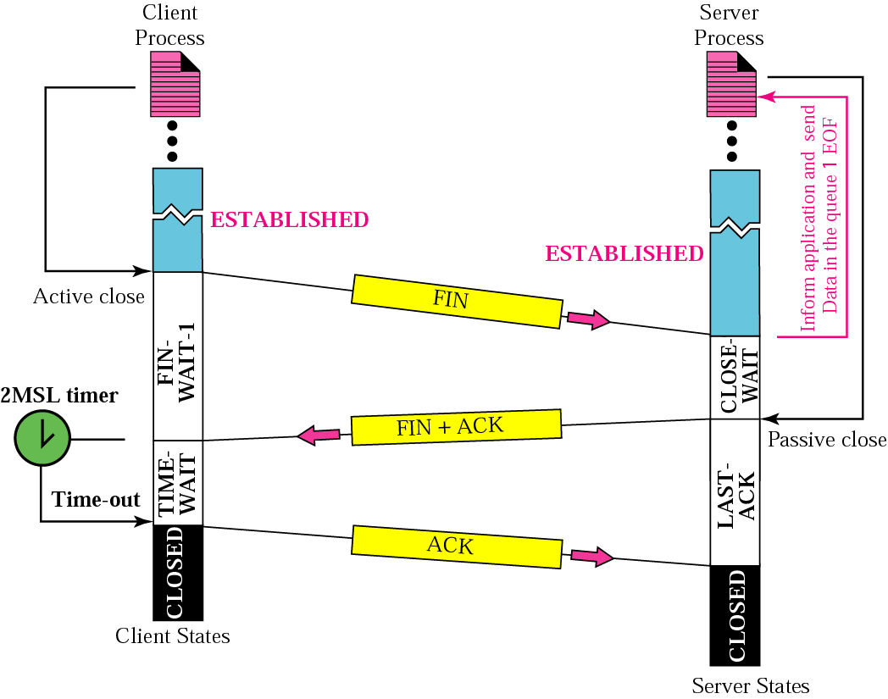
Connection termination using three-way handshake

Slide 26
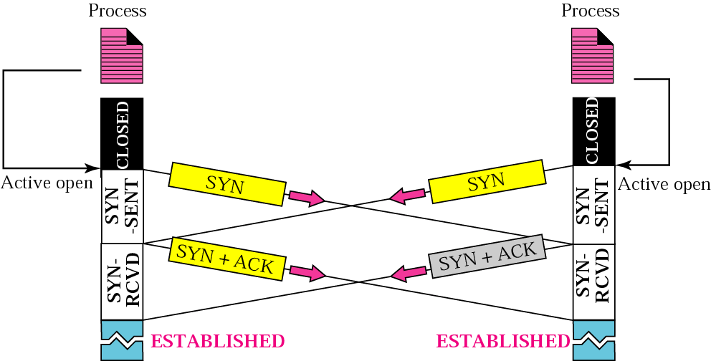
Simultaneous Open

Slide 27
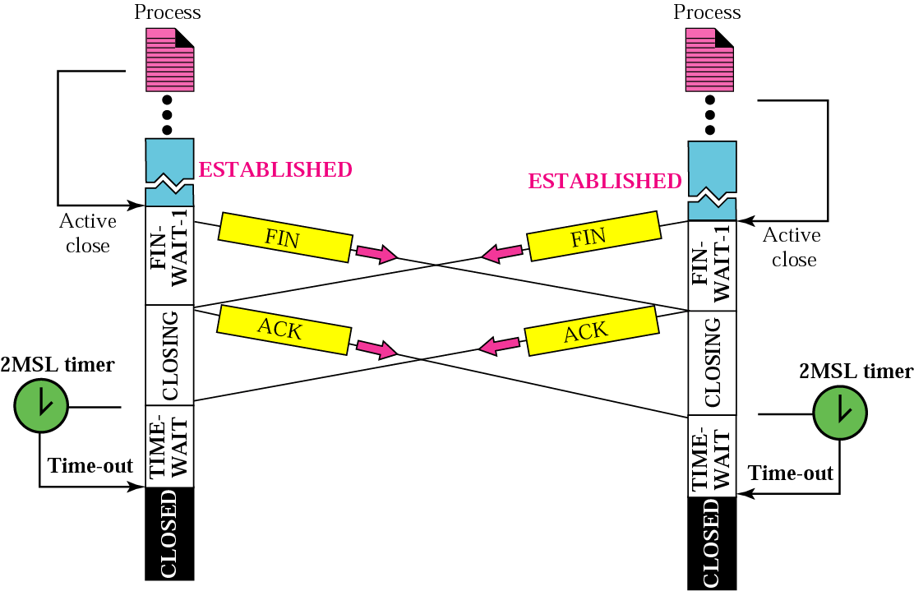
Simultaneous Close

Slide 28
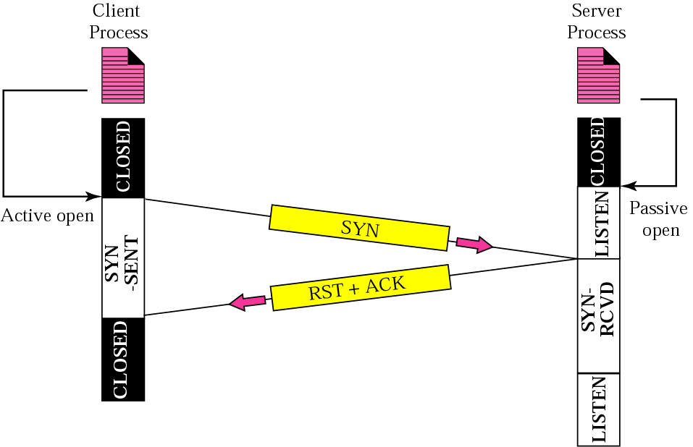
Denying a Connection

Slide 29
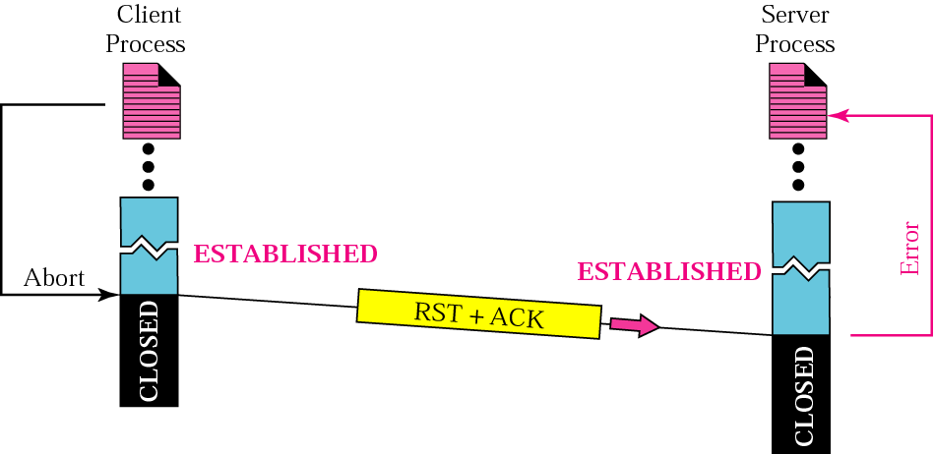
Aborting a connection

Slide 30
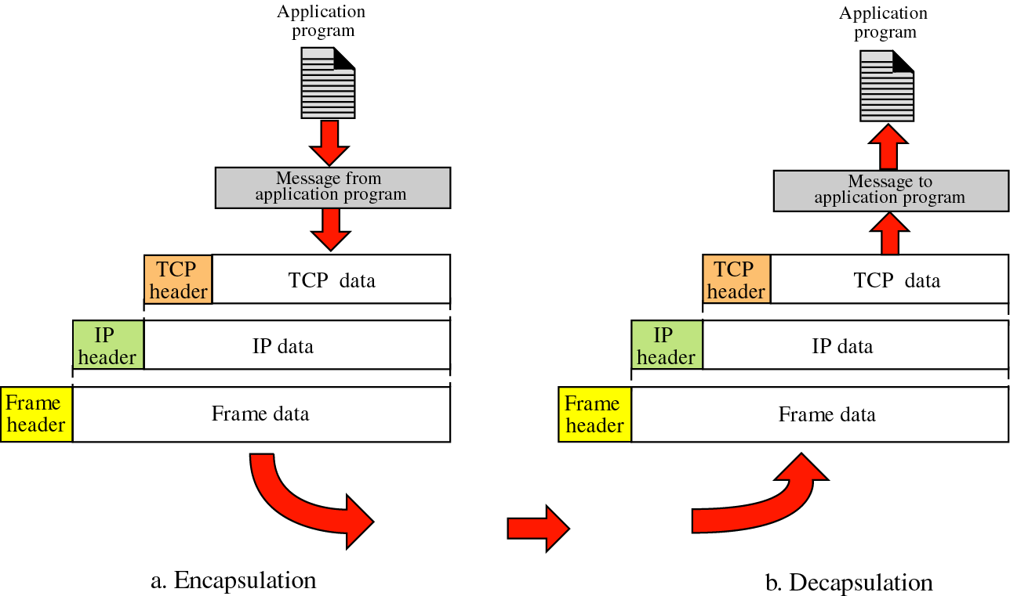
TCP OPERATION
Encapsulation and decapsulation

Slide 31
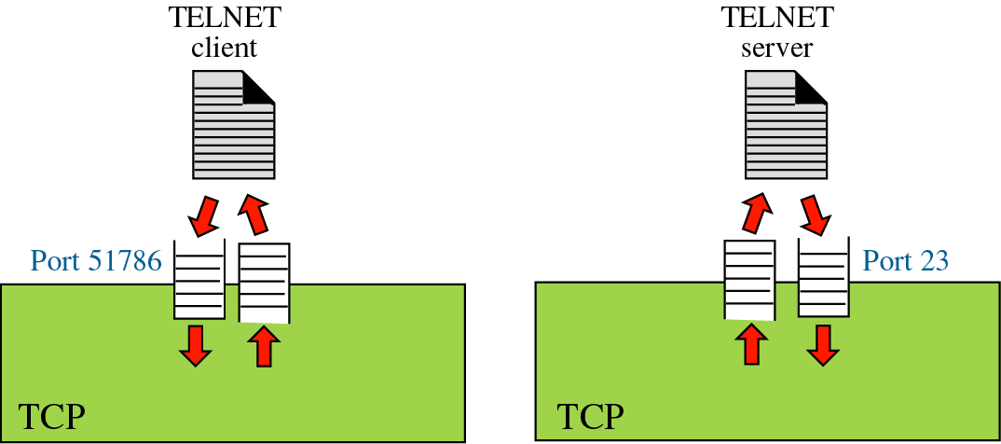
TCP OPERATION (cont.)
Buffering

Slide 32
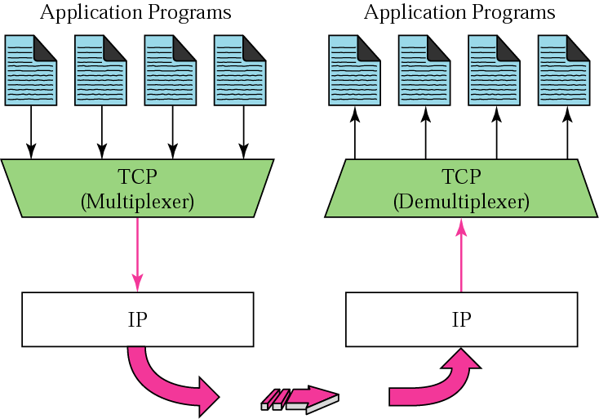
TCP OPERATION (cont.)
Multiplexing and demultiplexing

Slide 33
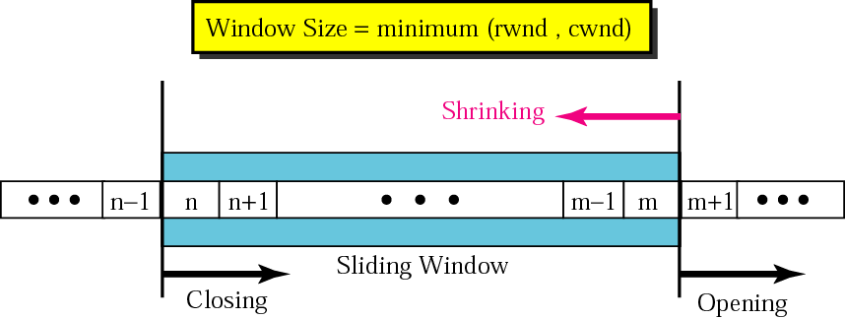
Sliding Window
rwnd: receiver window
cwnd: congestion window

Slide 34
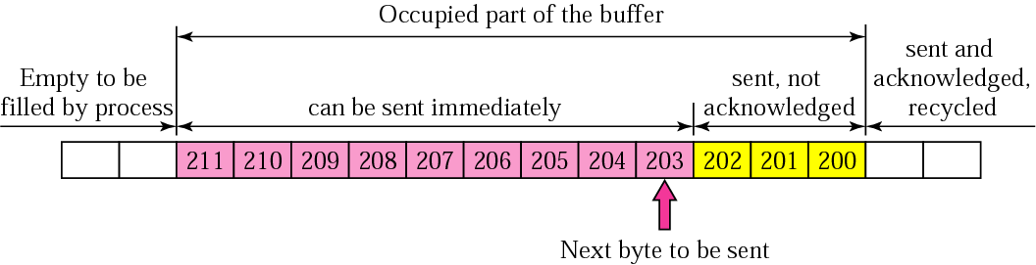
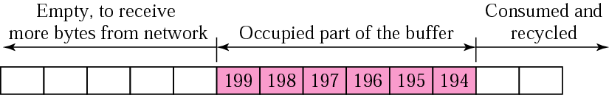
Sliding Window Protocol
Send buffer
Receiver window

Slide 35
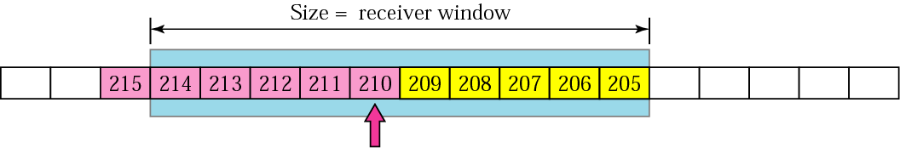
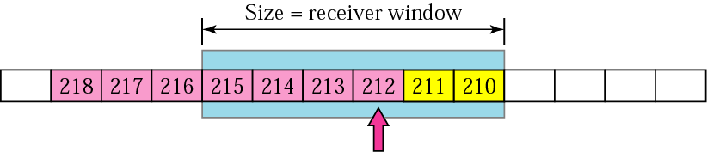
Sliding Window Protocol
Expanding the sender window
Shrinking the sender window
To avoid shrinking the sender window,
the receiver must wait until more space is available in its buffer.

Slide 36
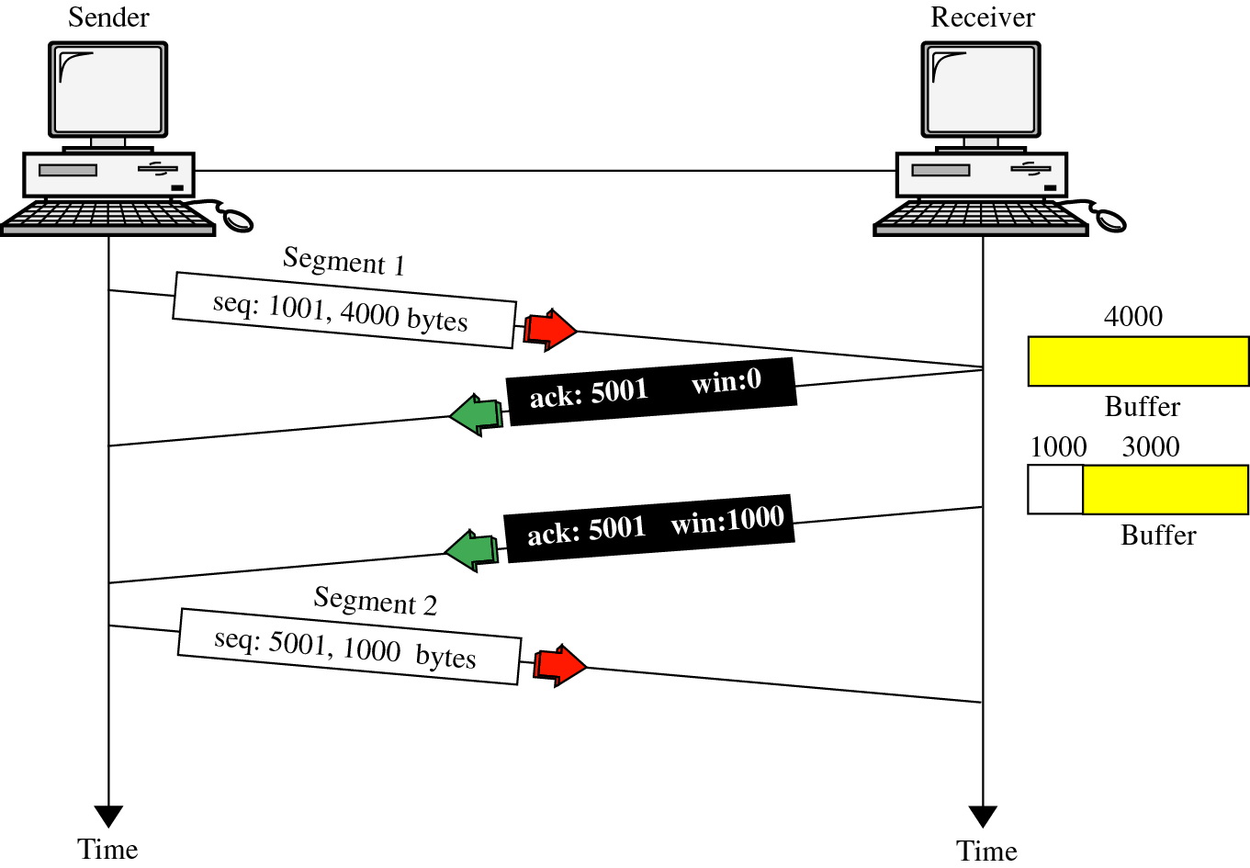
FLOW CONTROL (cont.)
Credit-based Window management
  Increase and decrease by receiving TCP

Slide 37
Delayed segment
  Delayed TCP segment are treated the same way as lost or corrupted segments by the receiver.
  The delayed segment may arrive after it has been resent (a duplicate segment)
Duplicate segment
  When a segment arrives that contains a sequence number less than the previously acknowledged bytes, it is discarded.

Slide 38
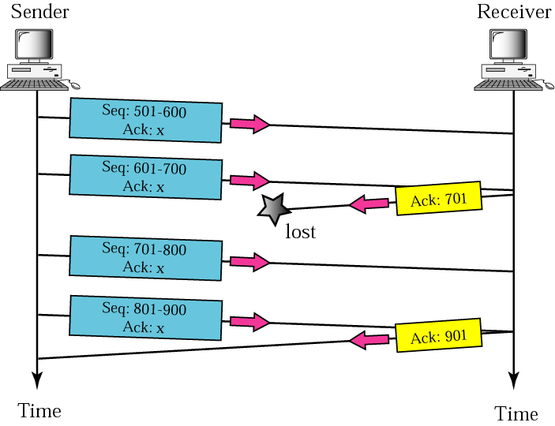
Automatically Corrected Lost Acknowledgment

Slide 39
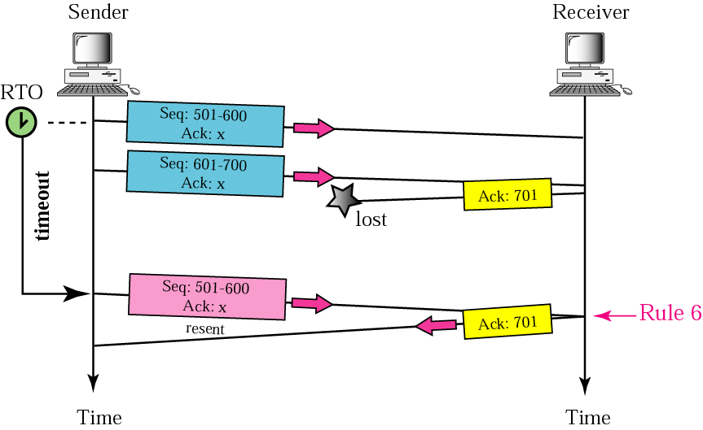
Lost acknowledgment corrected by resending a segment
Lost acknowledgments may create deadlock if
they are not properly handled

Slide 40
FLOW CONTROL (cont.)
Credit-based Window management
  Increase and decrease by receiving TCP

Slide 41
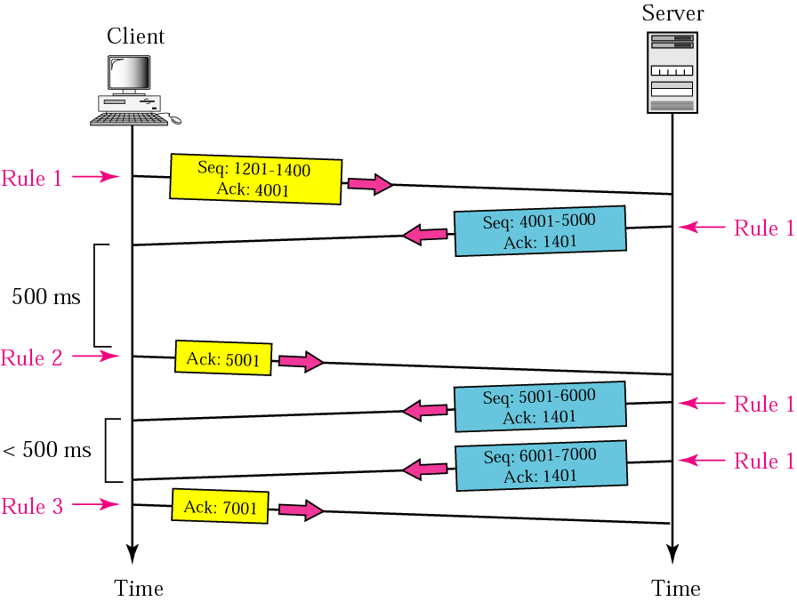
Normal Operation

Slide 42
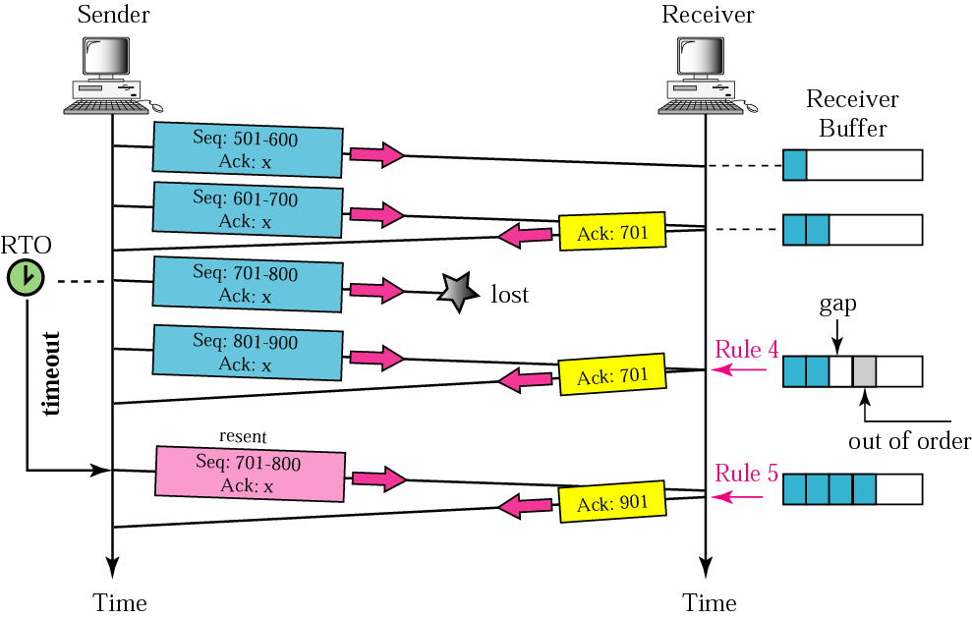
Lost segment
The receiver TCP delivers only ordered data to the process.

Slide 43
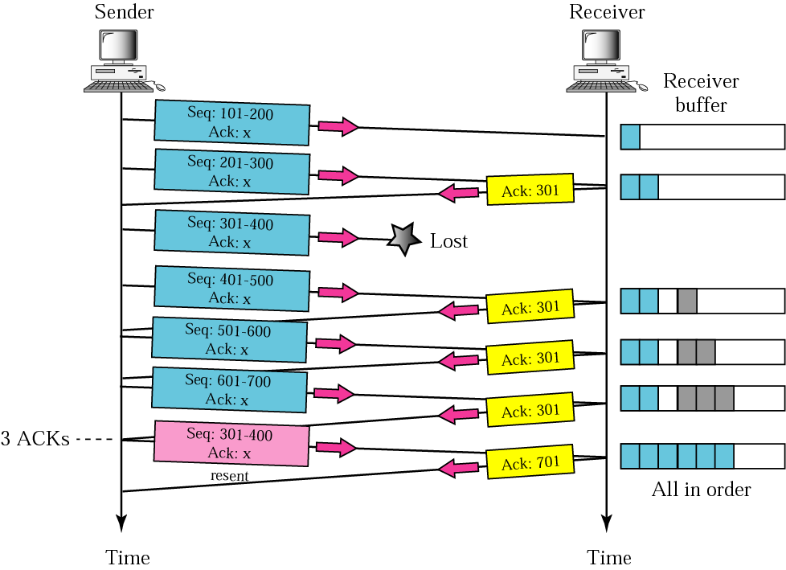
Fast retransmission

Slide 44
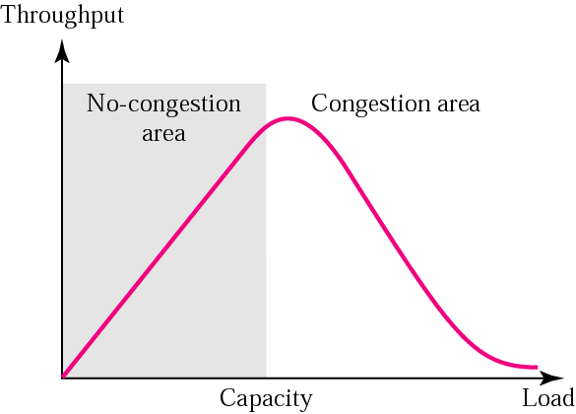
Congestion Control (cont’d)
Throughput versus Load
      the reason is the discarding of packets by the routers

Slide 45
Congestion Control in TCP
Congestion window
  Today, TCP protocols include that the sender’s window size is not only determined by the receiver but also by congestion in the network
  Actual window size = minimum (rwnd, cwnd)

Slide 46
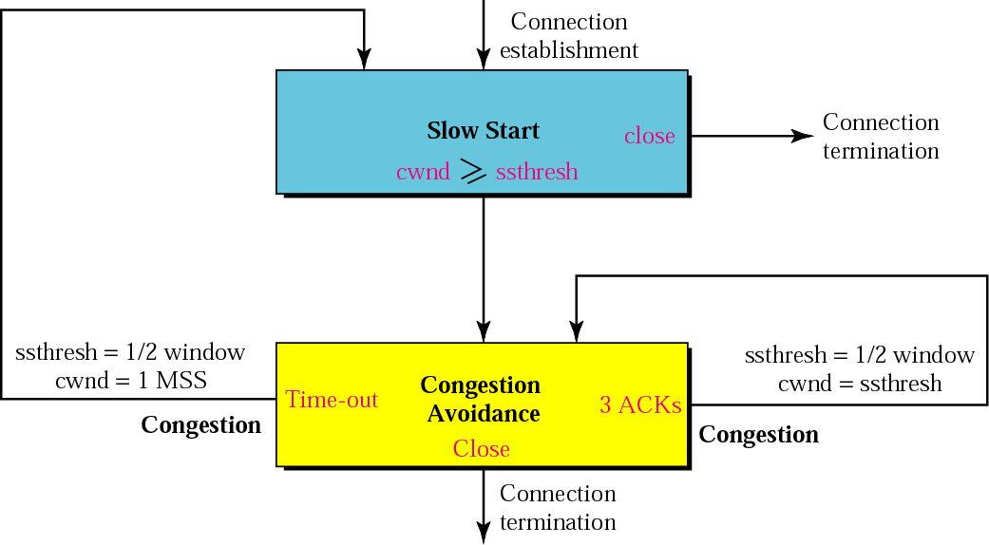
Congestion Control in TCP (cont’d)
TCP congestion policy summary

Slide 47
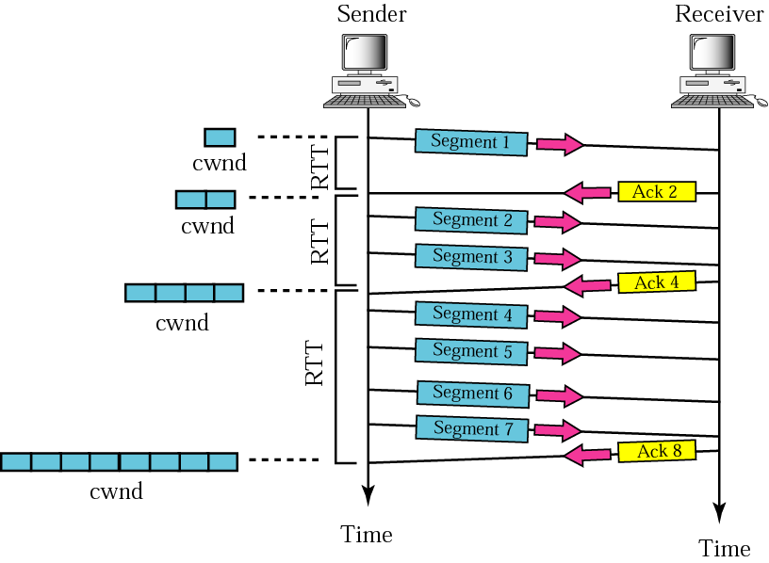
Congestion Control in TCP (cont’d)
Slow start: exponential increase
MSS (max. segment size)

Slide 48
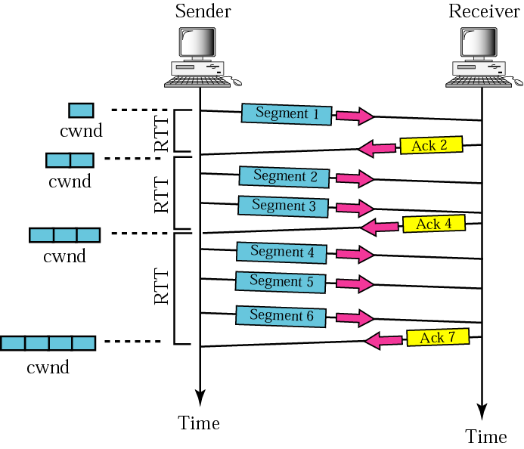
Congestion Control in TCP (cont’d)
Congestion avoidance: additive increase
  When the size of the congestion window reaches the slow start threshold, in the congestion avoidance algorithm, the size of the congestion window increases additively until congestion is detected

Slide 49
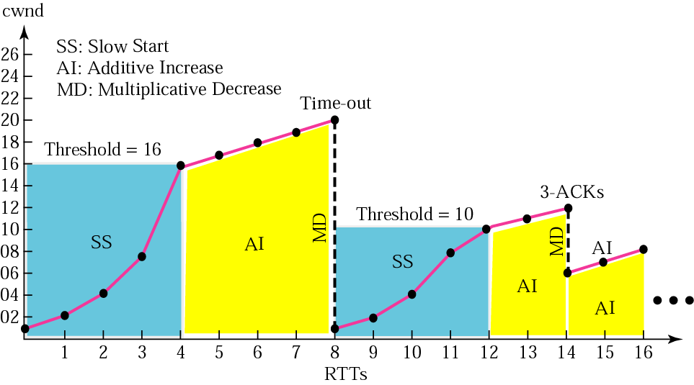
Congestion Control in TCP (cont’d)
Congestion example

Slide 50
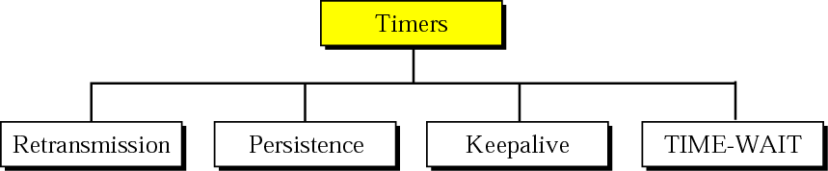
TCP Timers
To perform its operation smoothly, most TCP implementations use at least four timers

Slide 51
TCP Timers
Round Trip Time (RTT)
  To calculate the retransmission (RTO), we first need to calculate the round-trip time (RTT)
  In TCP, there can be only one RTT measurement in progress at any time
  Measured RTT (RTT_{M}) : how long it takes to send a segment and receive an acknowledgment of it

Slide 52
TCP Timers
Smoothed RTT (RTT_{S}) : Weighed average of RTT_{M} and previous RTT_{S}
  Original → No Value
  After first measurement → RTT_{S} = RTT_{M}
  After any other measurement →
RTT_{S} = (1- α) RTT_{S} + α · RTT_{M}
The value of α is implementation-dependent, but it is normally set to 1/8

Slide 53
TCP Timers
RTT Deviation (RTT_{D})
  Original → No Value
  After first measurement → RTT_{D} = RTT_{M}/2
  After any other measurement
  → RTT_{D} = (1- β) RTT_{D} + β · l RTT_{S} – RTT_{M} I
  The value of β is also implementation dependent, but is it is usually is sent to ¼.

Slide 54
TCP Timers
Retransmission Timeout (RTO)
  Original → Initial Value
  After any measurement → RTO = RTT_{S} + 4 RTT_{D}

Slide 55
TCP Timers
Persistence Timer
  When acknowledgment with non-zero window size after zero window size is lost, to correct deadlock, TCP uses a persistence timer for each connection
  When the sending TCP receives an acknowledgment with a window size of zero, the persistence timer is started
  When persistence timer goes off, the sending TCP sends a special segment called a probe
  The probe alerts the receiving TCP that the acknowledgment was lost and should be resent
  If a response is not received, the sender continues sending the probe segments and doubling, and resetting the value of the persistence timer until the value reaches a threshold (usually 60 seconds)
  After that sender sends one probe segment every 60s until the window is reopened

Slide 56
TCP Timers
Keepalive Timer
  Used to prevent a long idle connection between two TCPs.
  Each time the server hears from a client, it resets this timer
  Time-out is usually 2 hours
  After 2 hours, sending 10 probes to client (each 75 secs), then terminates connection
TIME-WAIT Timer
  The time-wait timer is used during connection termination

Slide 57
